Slide 1




CYBERTRUST
CYBR 4580 - 8950 capstone project
https://cornsec.pw/

Slide 2
Outline
Project Summary
Risk List
Project Methodology
Site Mockups
Framework
Sprint Plan

Slide 3
Project Summary
We will supplement the current web application by adding additional user and admin tools:
Segment the user base into Administrative and User groups to allow separated functionalities.
Provide an administrator screen which fill provide a consolidated toolset for creating reports.
Create a user statistics screen to display analytics relating to individual usage.

Slide 4
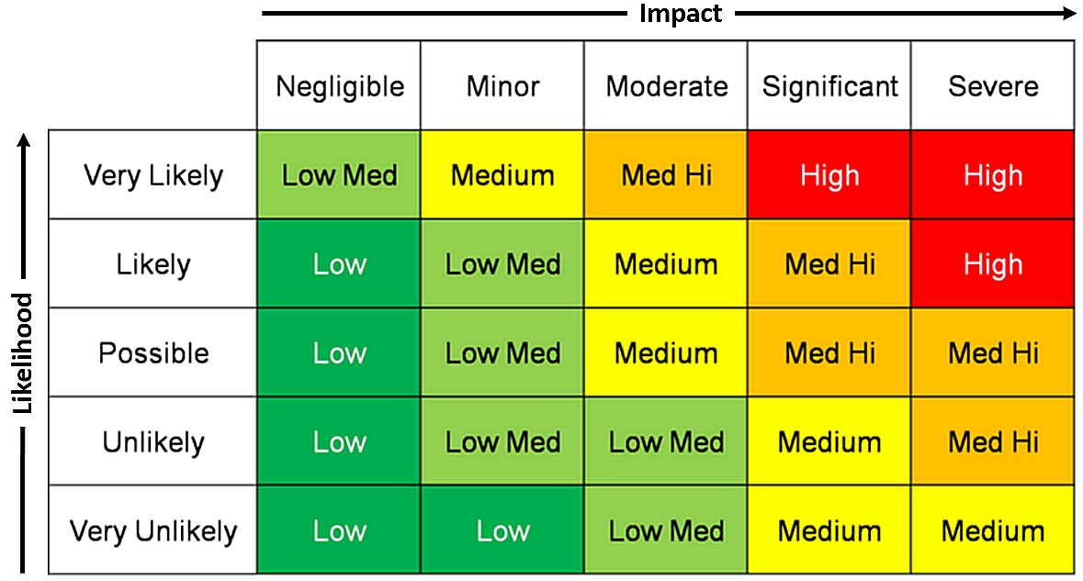
Project Risks
Risks Identified within project
Meeting / Scheduling conflict
Project Member leaves or reassigned
Unable to learn EmberJS

Slide 5
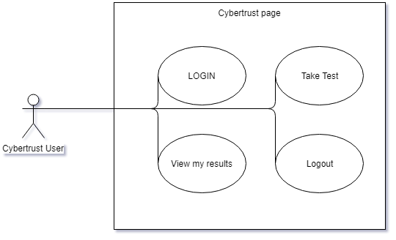
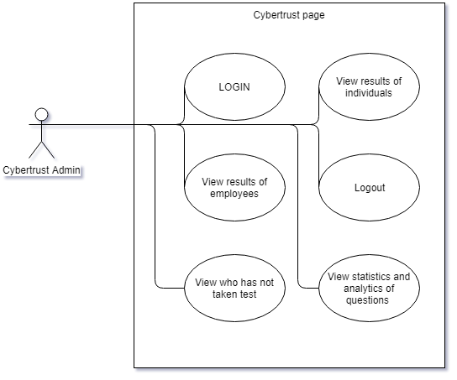
Project Methodology
Establish user and admin accounts within the existing cybertrust infrastructure.

Slide 6
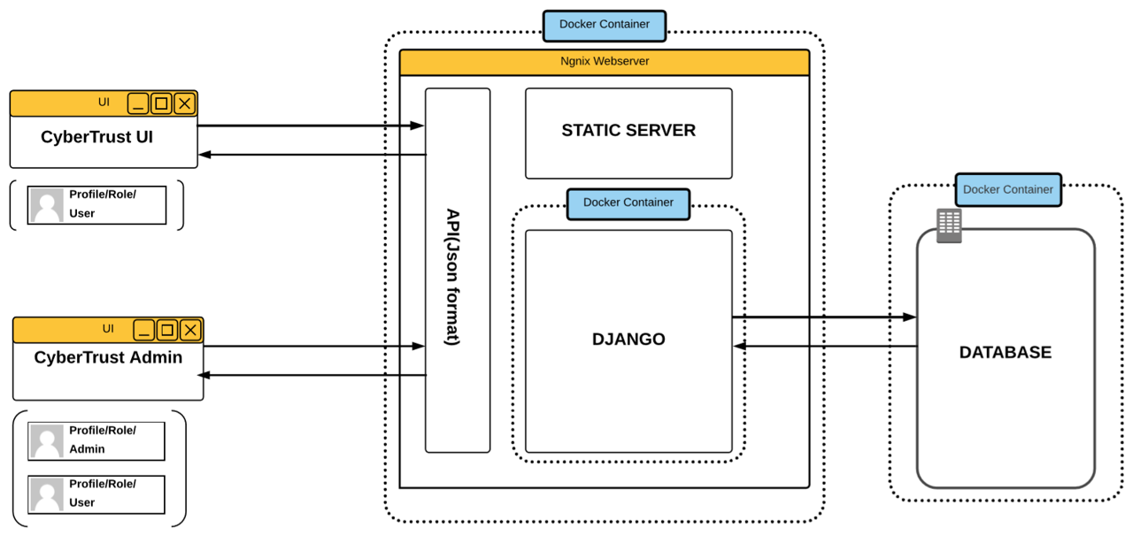
Site Mockups
Infrastructure already exists!
We will expand on this infrastructure by providing additional front end components and ensuring the backend can handle the new inputs with additional API’s

Slide 7
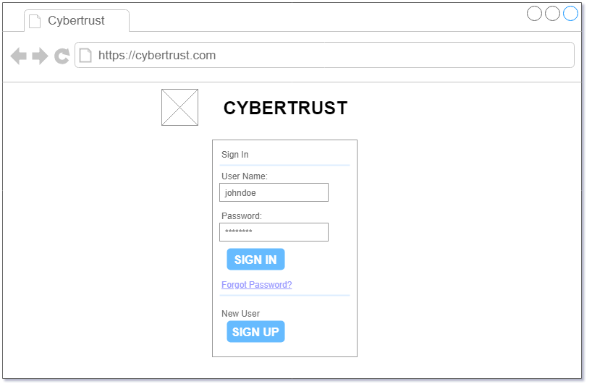
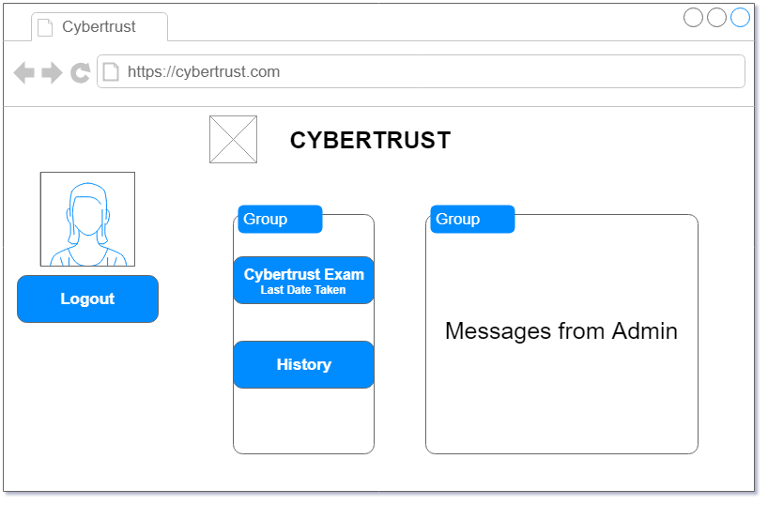
Site Mockups
Infrastructure already exists!
We will expand on this infrastructure by providing additional front end components and ensuring the backend can handle the new inputs with additional API’s

Slide 8
Project Framework
Ember.js
Django
Python
PostgreSQL
The team will utilize various tools within this project.

Slide 9
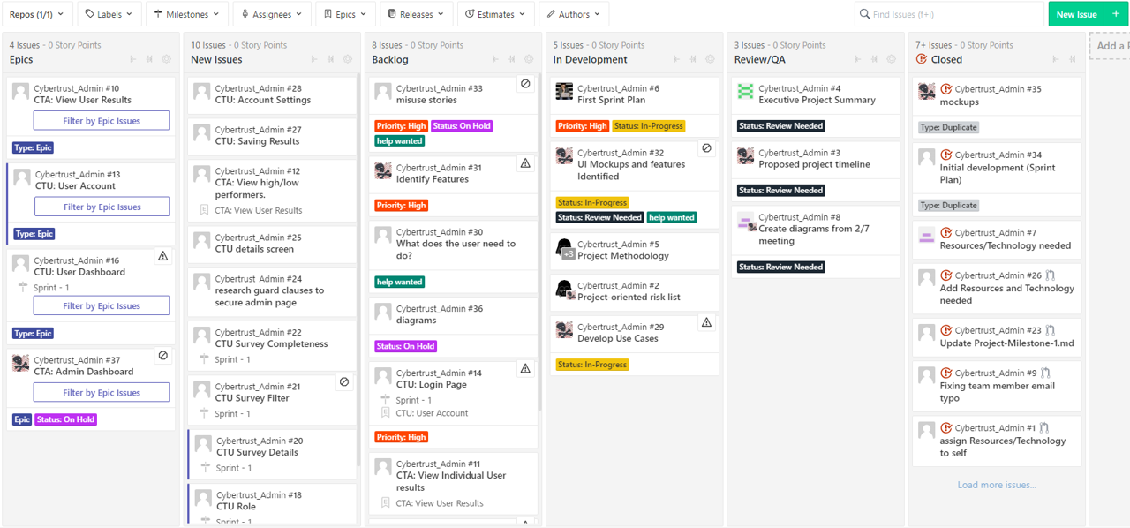
Sprint Plan

Slide 10
Assumptions
We assume that the established framework will not be affected by new additions
We assume that the current login and signup pages can be adopted into this project
We assume the dashboard will be able to call the current api and make use of the information
We assume the testing server will be available to all members of the team

Slide 11
Questions?

Slide 12
Solution description
Now that you’ve justified your attention to the problem, summarize your solution in one or two sentences.

Slide 13
Why it’s better than existing solutions
Return to the problem now that you’ve introduced your solution. Compare your solution to others and describe how it is superior.

Slide 14
Wireframes

Slide 15
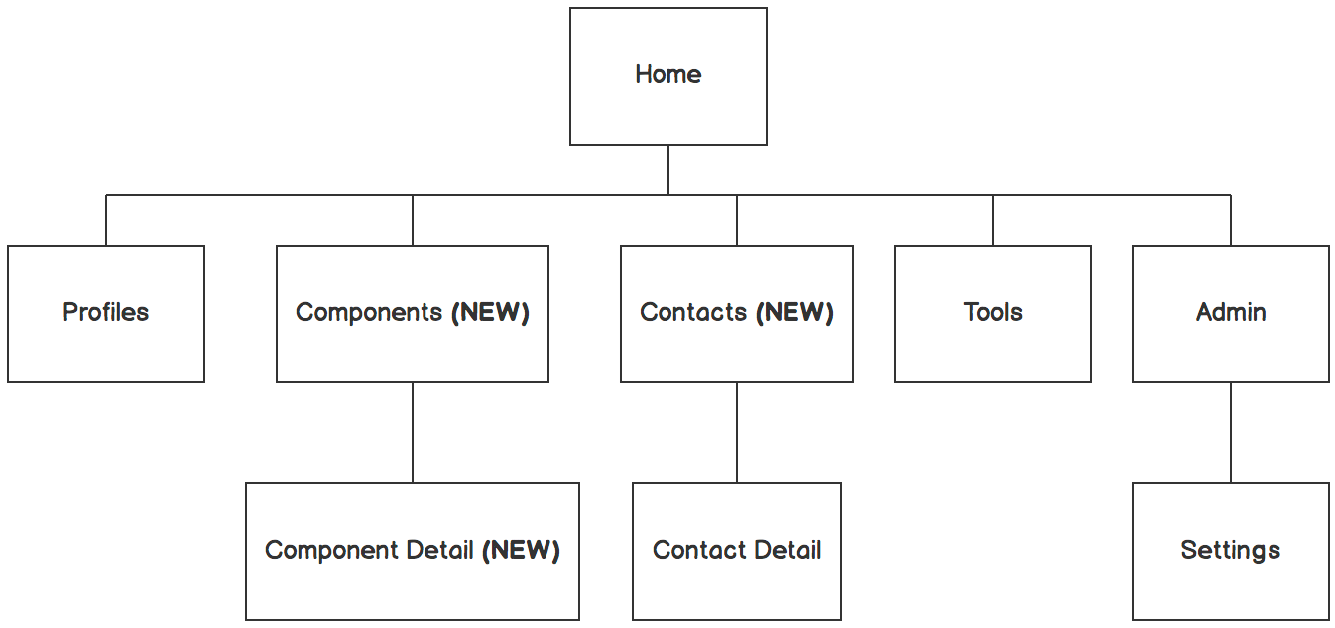

Information architecture
Balsamiq Tip | Information architecture is the flow of content across the site or application (more info).

Slide 16
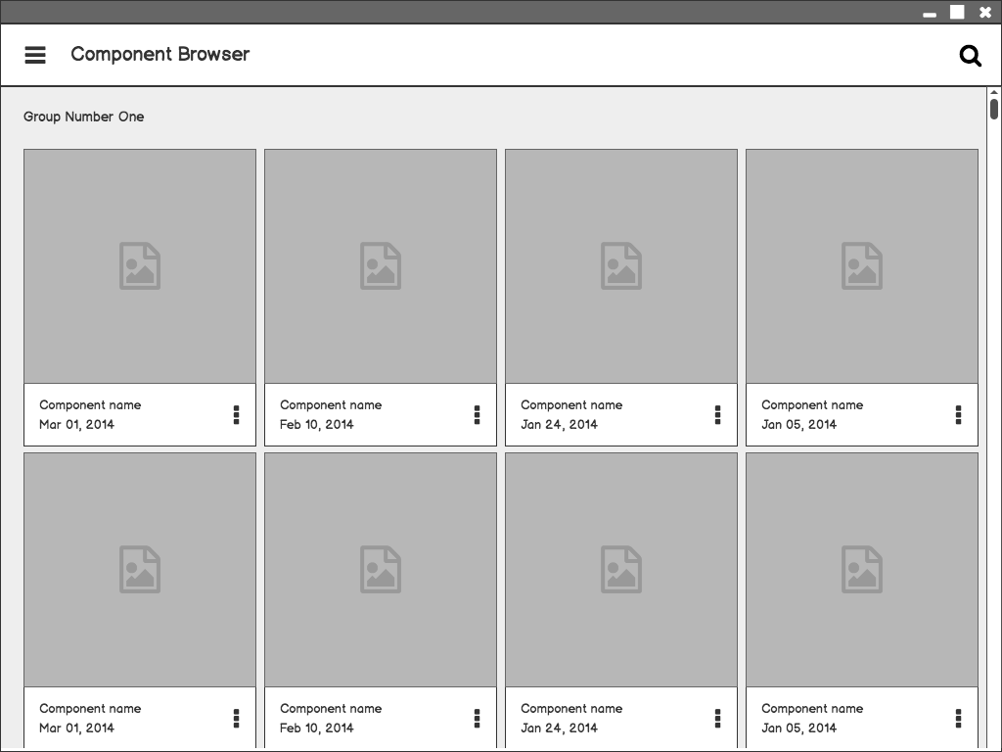
Component Browser
Call out key parts of the UI
Balsamiq Tip | Use the Balsamiq add-on to make your own wireframe.

Slide 17
Component Detail

Slide 18
Component Detail (Mobile)
Articulate your design decisions by adding justifications

Slide 19
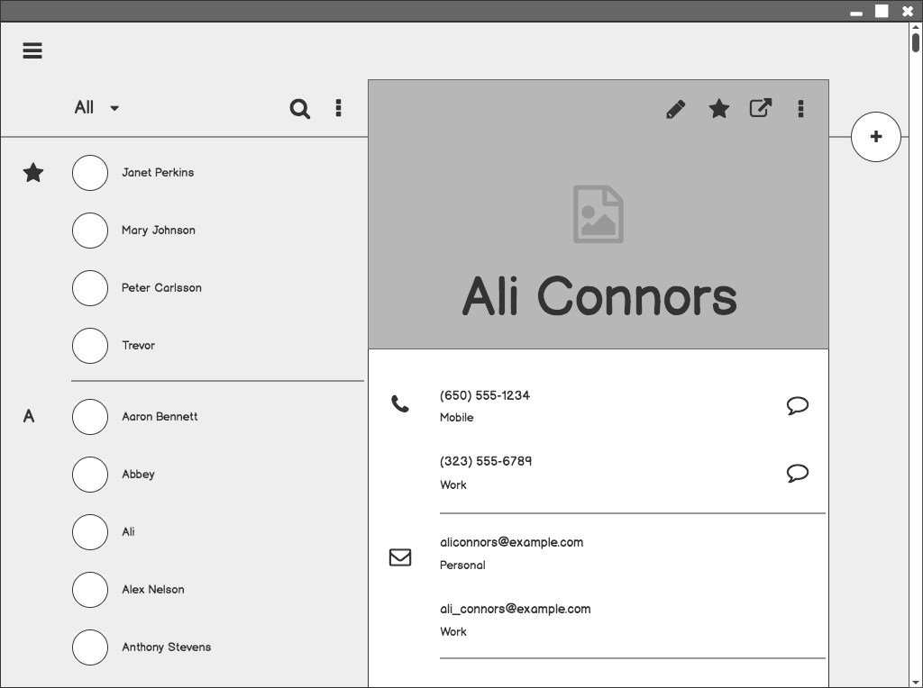
Contacts

Slide 20
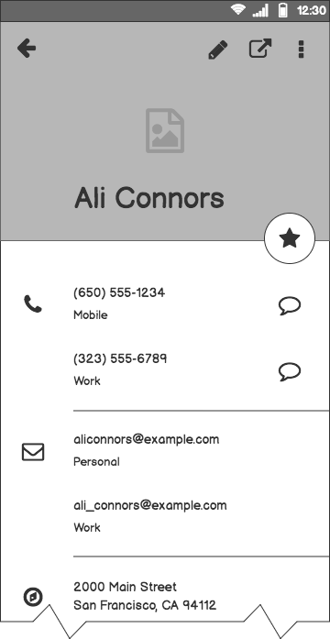
Contacts (Mobile)

Slide 21
Next Steps

Slide 22
What next?
Present the timeline.
Solicit comments on these slides or reviews on these wireframes in the Balsamiq add-on.
User testing plan.

Slide 23
Timeline
MAY
JUN
TODAY
AUG
SEPT
OCT
NOV
Requirements gathering
User research
Wireframes
Review
Prototype
User testing
Dev hand-off

Slide 24
Questions?

Slide 25
References
Tips for Presenting Your Wireframes
3 Steps to Better UI Wireframes
Wireframing for Beginners

